Slide 1
Sunday 13th August 2017

Slide 2
Seeing spots…should I be worried?
Dr Christolyn Raj
CATARACT SURGERY
RETINAL DISEASE
GENERAL OPHTHALMOLOGY

Slide 3
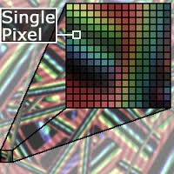

Slide 4
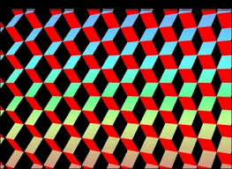

Slide 6
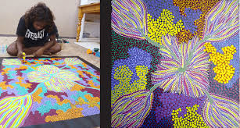

Slide 7
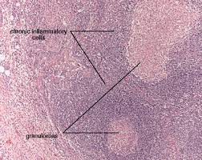
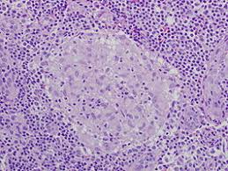

Slide 8
DARK SPOTS

Slide 10
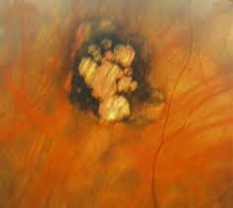

Slide 12
WELL DEMARCATED
ELEVATED
ATROPHY

Slide 15
ATROPHY : PIGMENT
EXCAVATED APPEARANCE =CHORIORETINAL

Slide 17
Considering...DARK SPOTS
What can we summarize from darker lesions?
Often longstanding
Well circumscribed = often inactive
Can change over time : darker/deeper/extensive

Slide 18
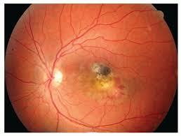
When should you refer?
If any other associated pathology co=exists

Slide 19
LIGHT SPOTS

Slide 20
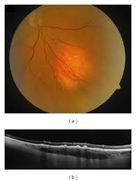
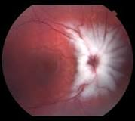
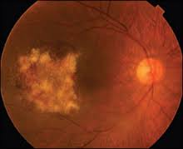

Slide 21
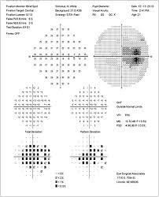

Slide 28
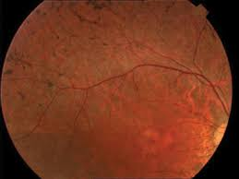
Considering LIGHT SPOTS
Pattern recognition

Slide 29
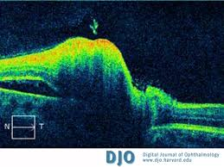
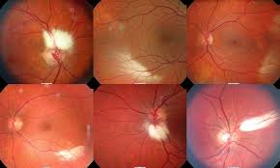
Considering LIGHT SPOTS
Recognize the layer of retina involved

Slide 30
COLOURED SPOTS

Slide 31
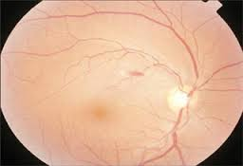

Slide 34
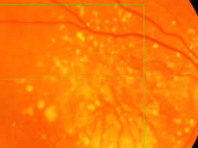

Slide 37
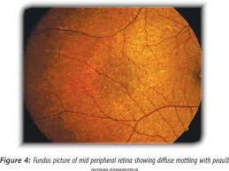

Slide 39
Take home messages
Look at the big picture
Remember to SPOT !

Slide 40
S : Confirm the SPOT
P : Look for a PATTERN
O : Is it involving the OUTER retina?
T : Determine the TIME FRAME : acute or chronic?

Slide 41
www.theretinalhub.com
Launched Feb 2017
To foster co-management and a tool for sharing knowledge
2,235 HITS
Case studies featured in Mivision

